Slide 1
Colour Assignment Iterations
Timothy Roberts

Slide 2


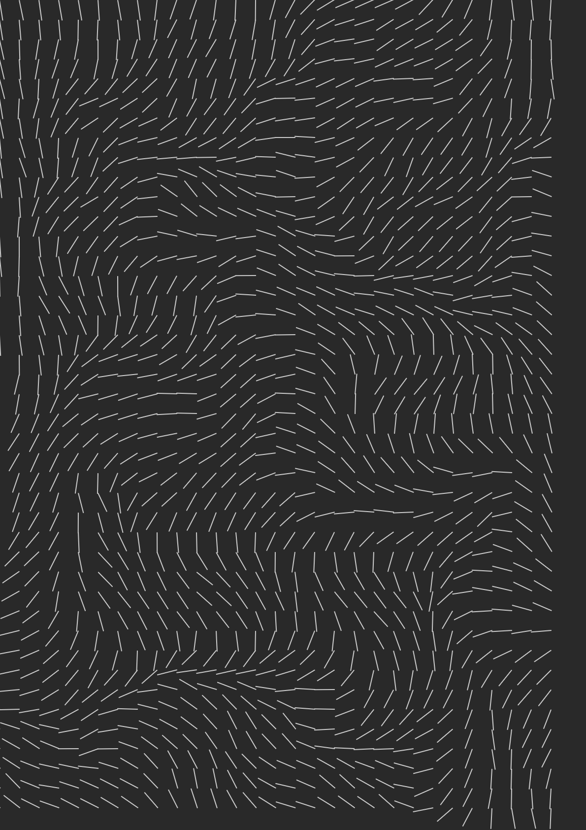
1. Create Grid, randomize vector angles, perlin noise angles

Slide 3



2. Background Particles, check edges bug, first interpolation

Slide 4



3. Further interpolation, random gaussian position, perlin noise strokeweight

Slide 5



4. Drawing over layer bug, Layers Class, Pattern bug + drawing over layers temp fix

Slide 6

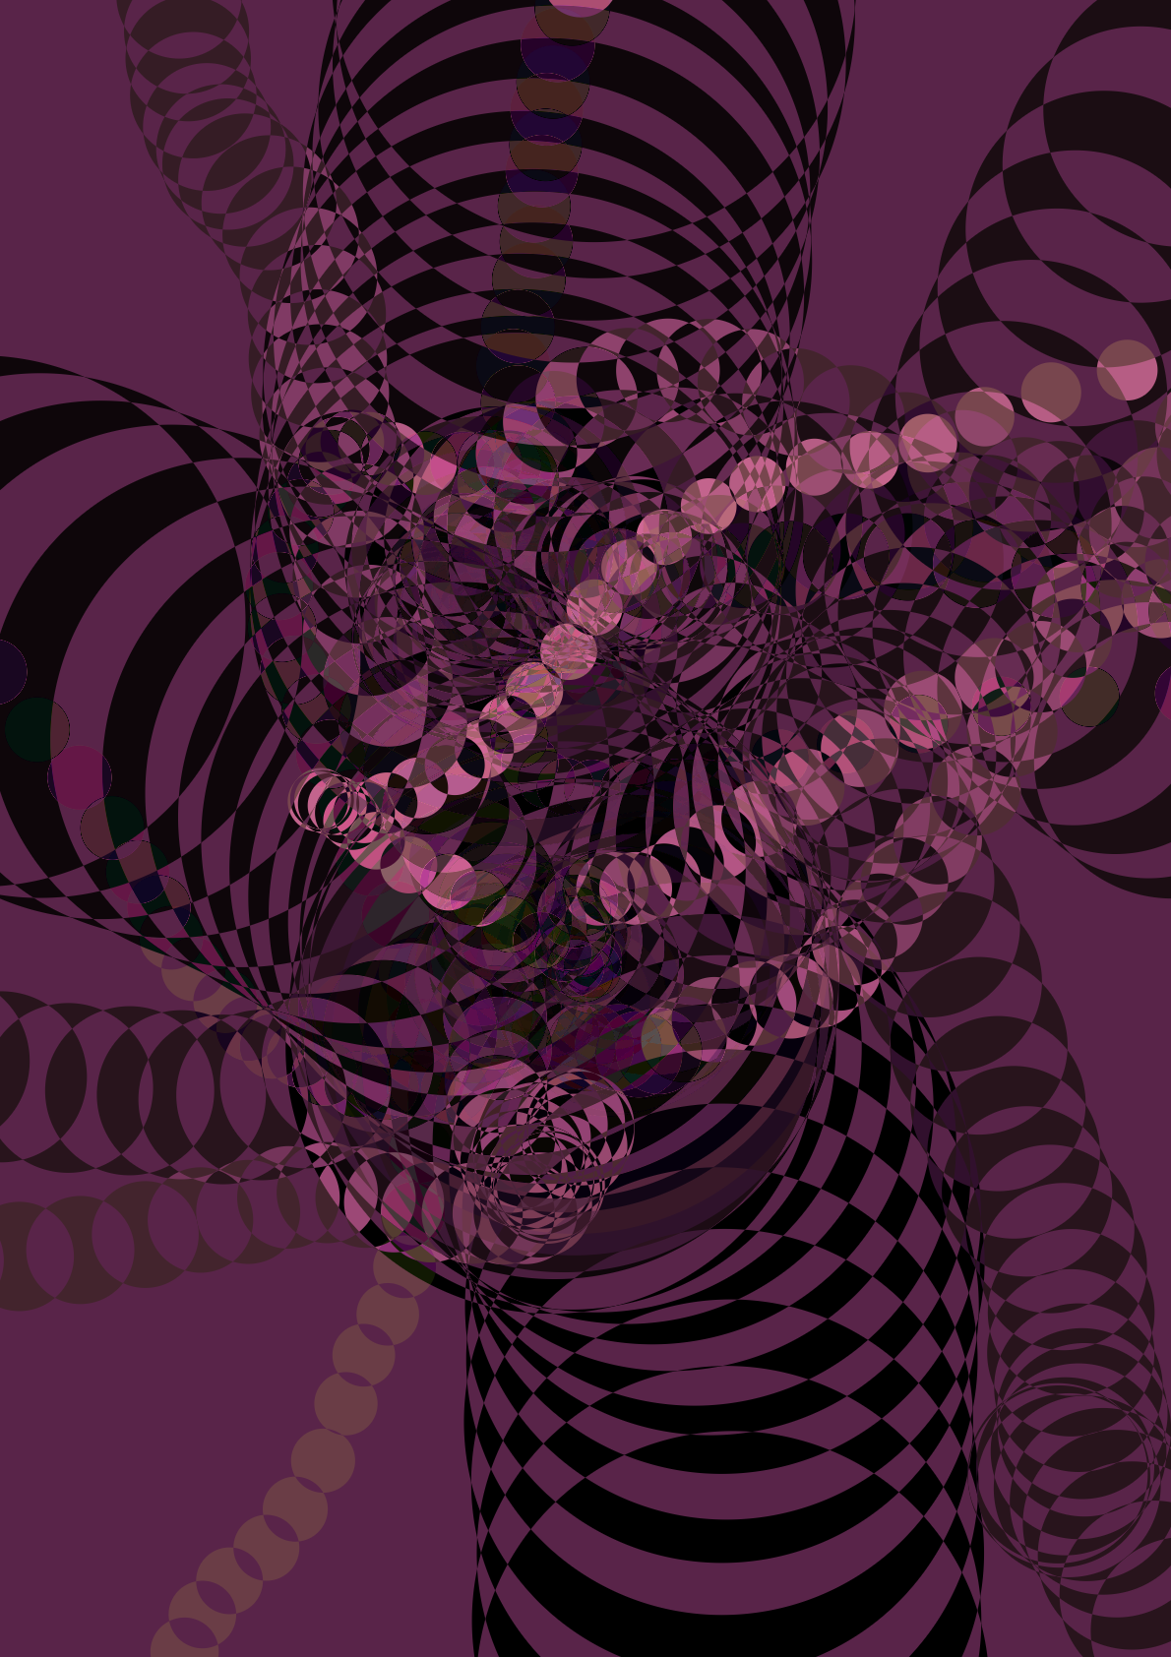

5. Set timeout attempt, playing with blendmodes, Adding a foreground layer class

Slide 7

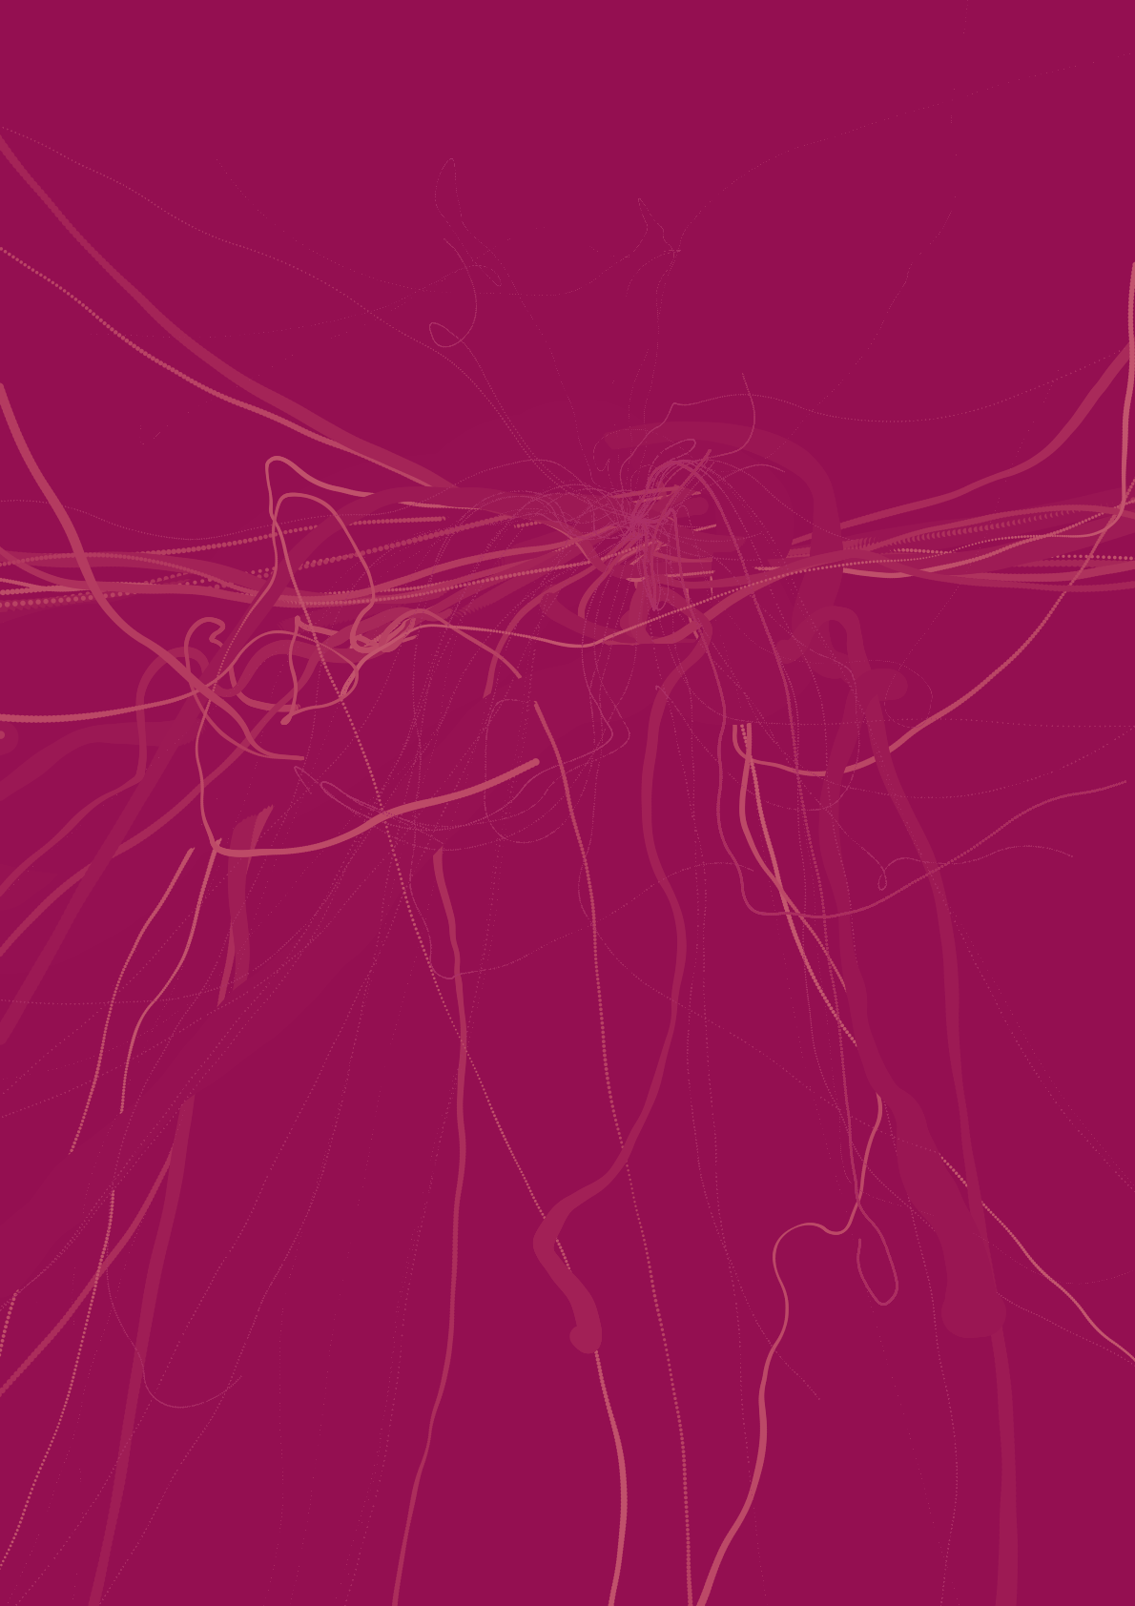
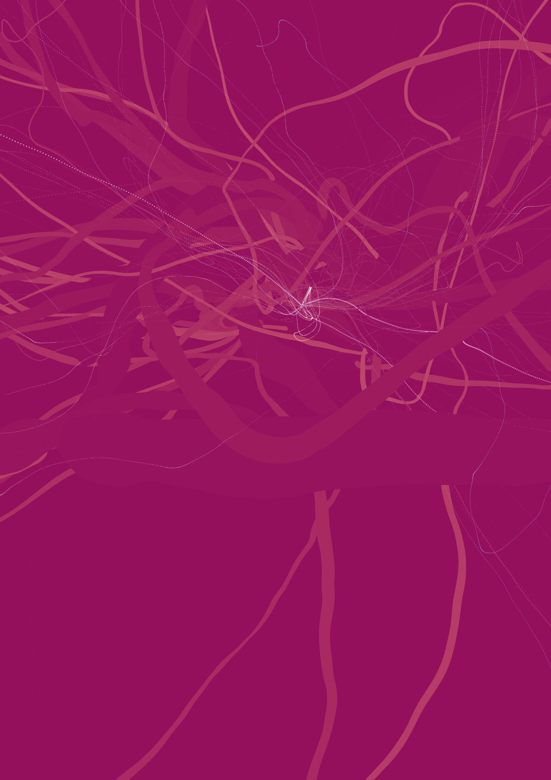
6. Flowfield pattern fix, background and foreground development, experimenting with analogous colours, highlight layer added!

Slide 8
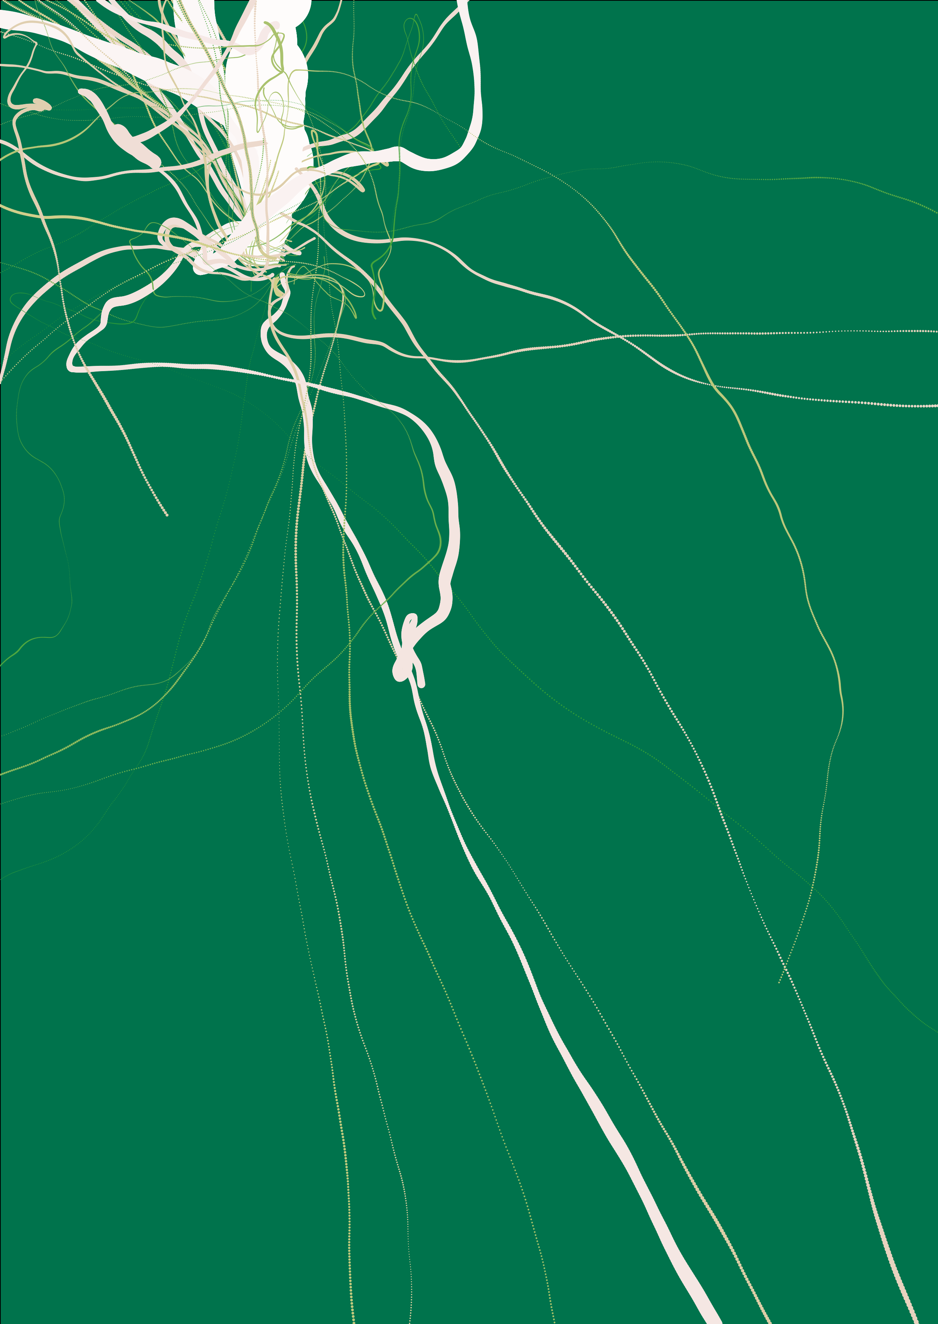
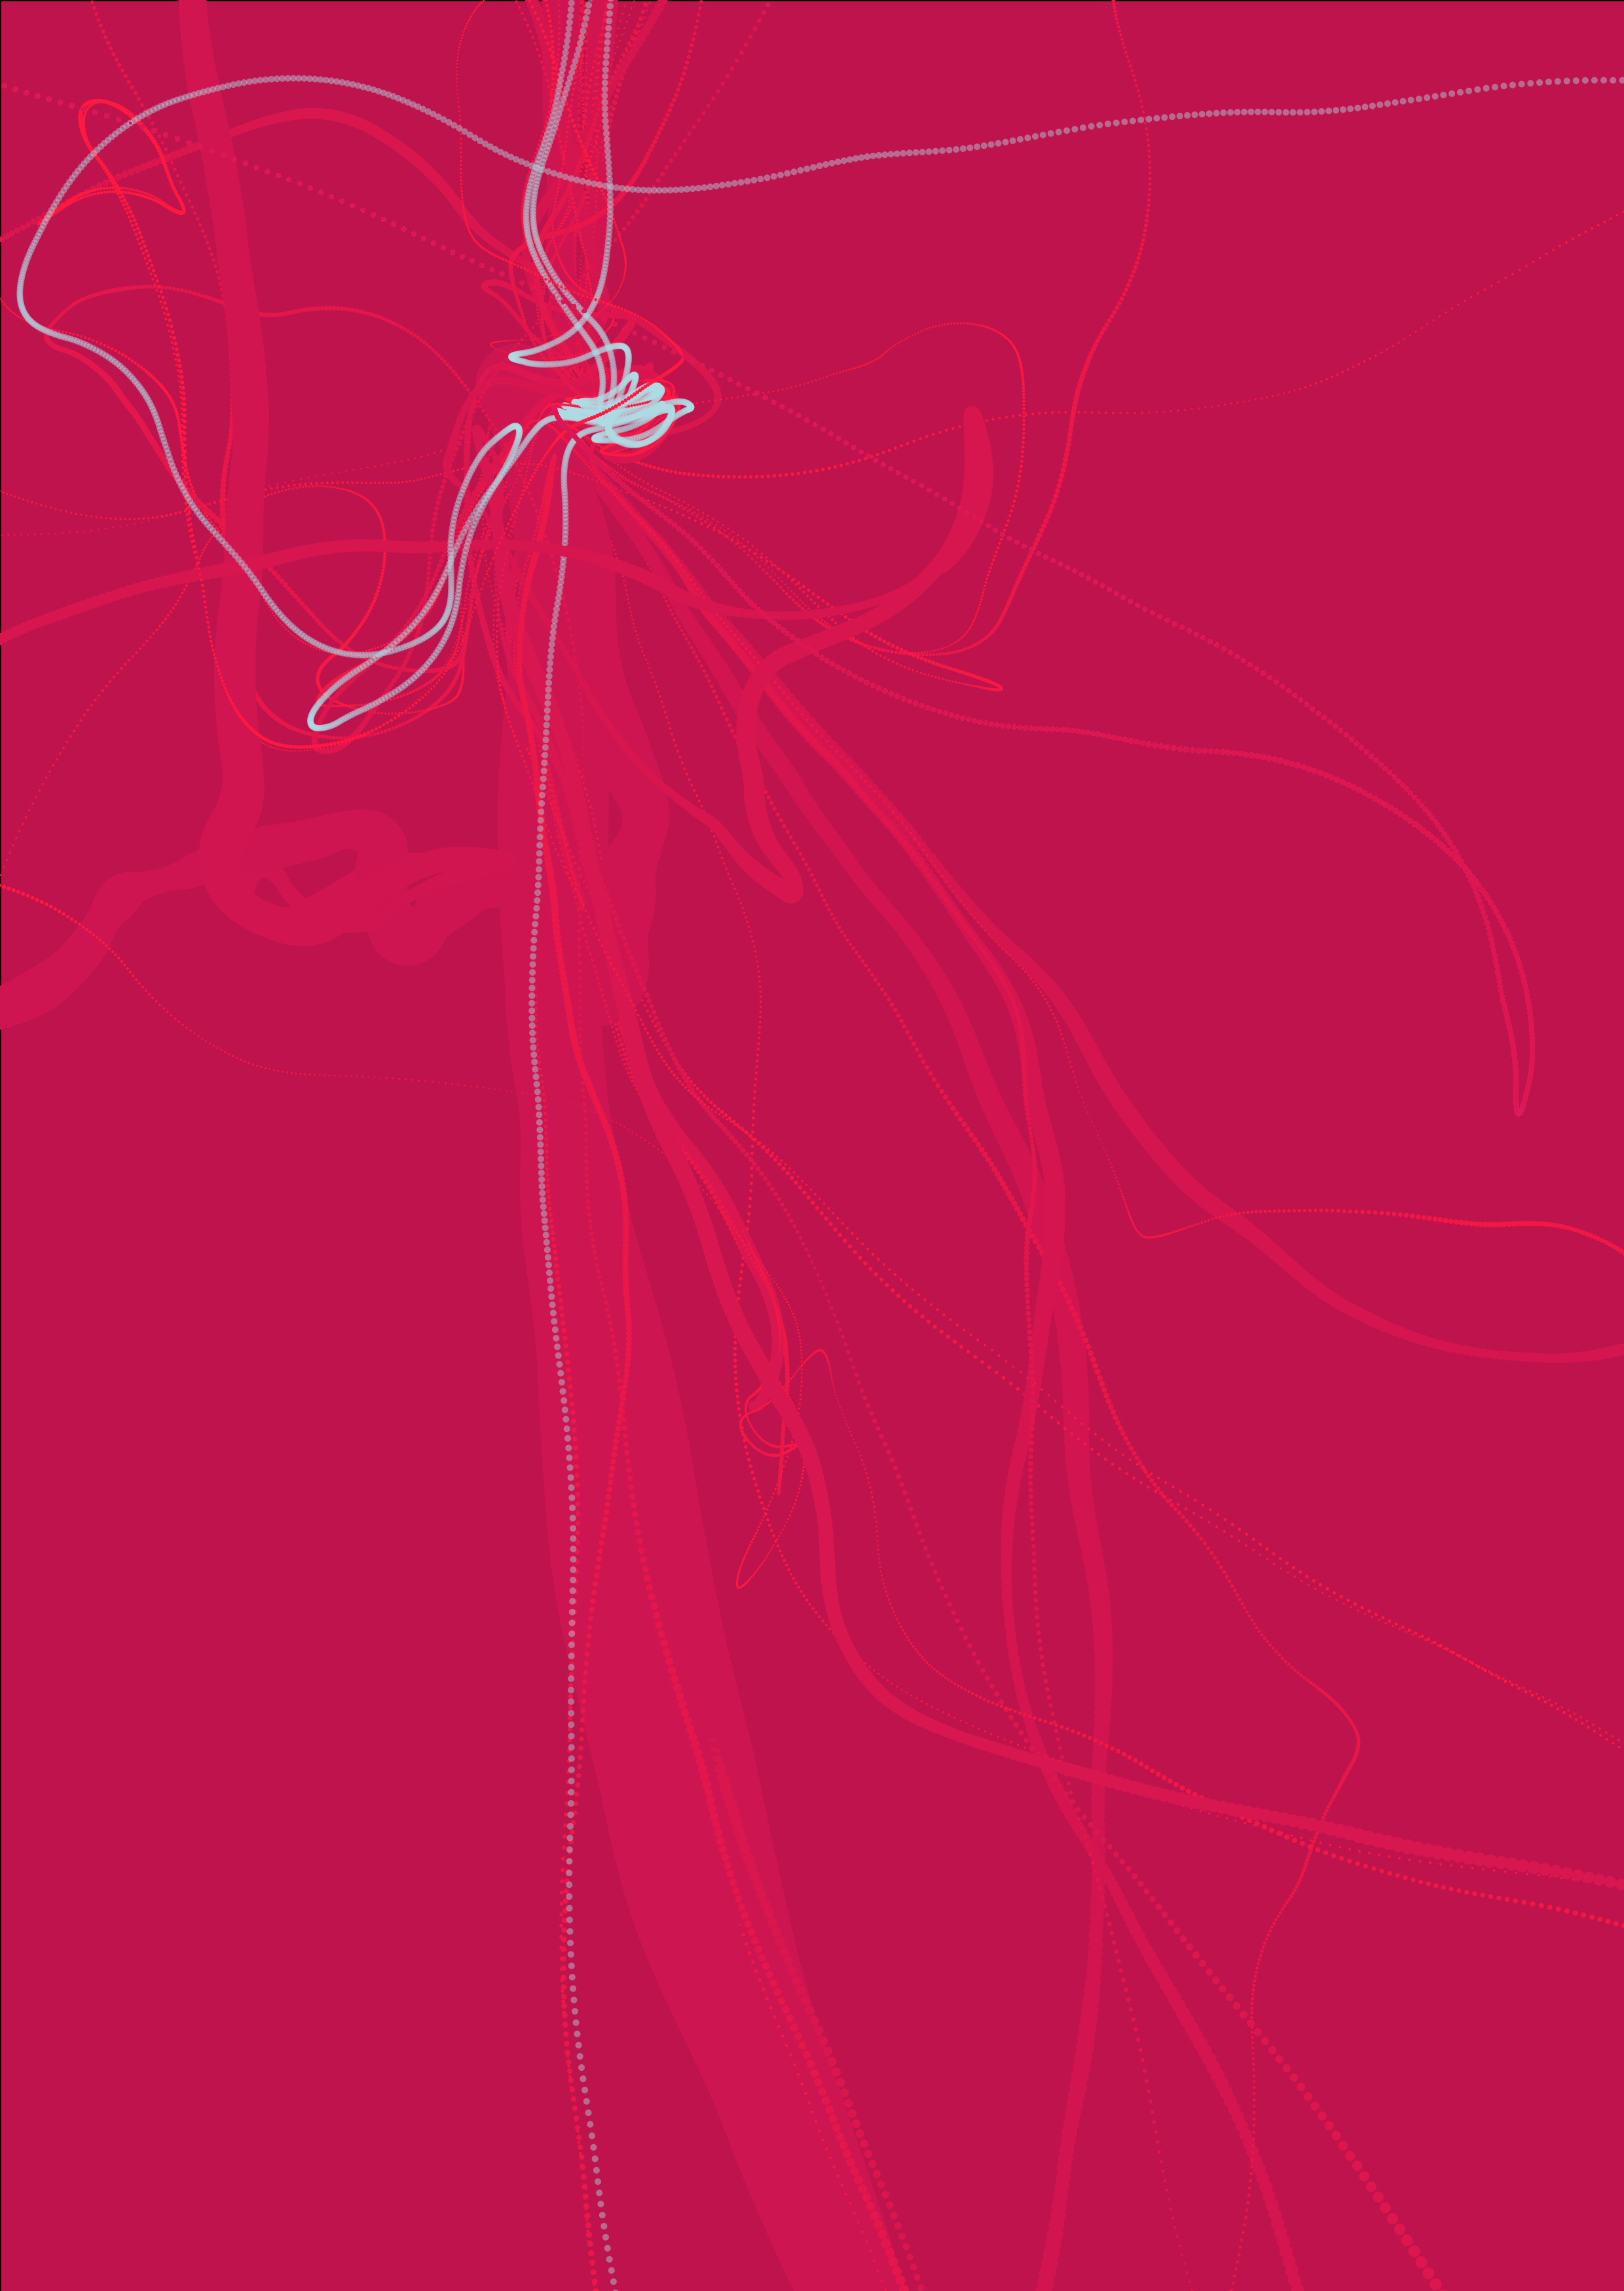

7. Refined strokeweight, Refined layers class & extended classes, colour refinement, removed mouseclick for consistency

Slide 9
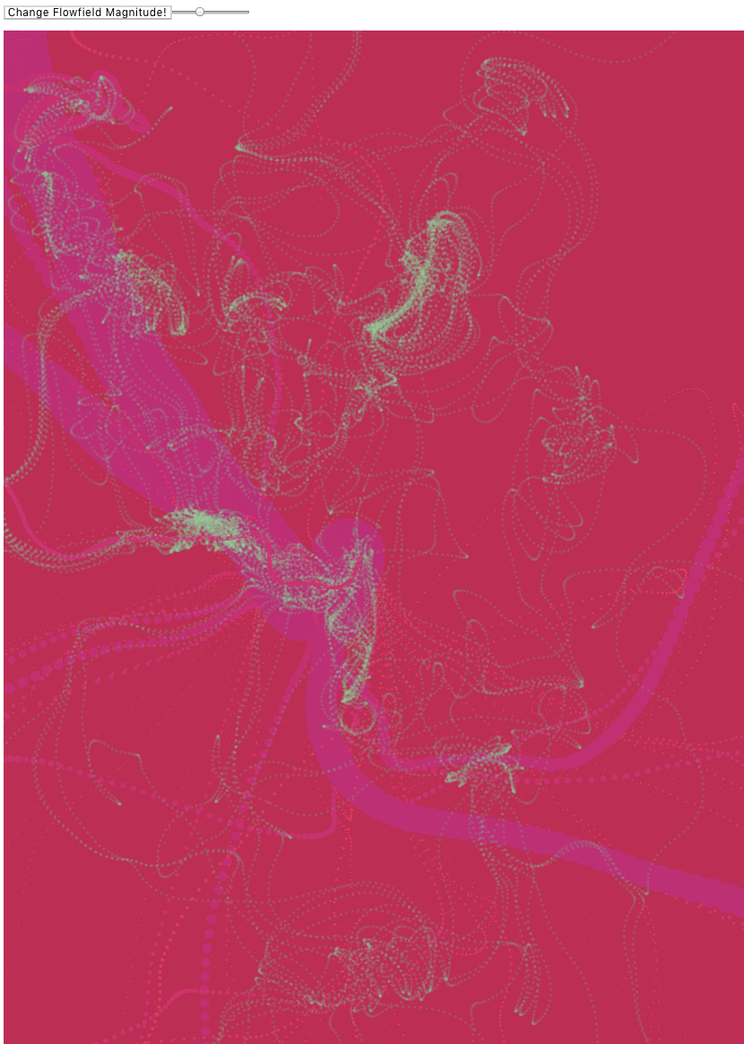
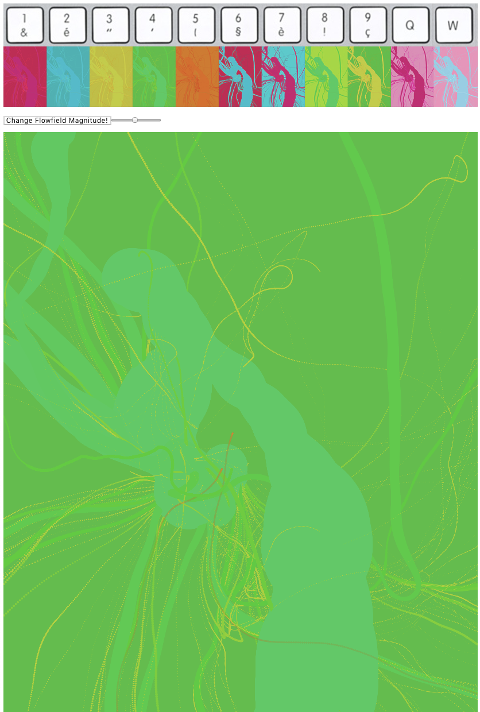
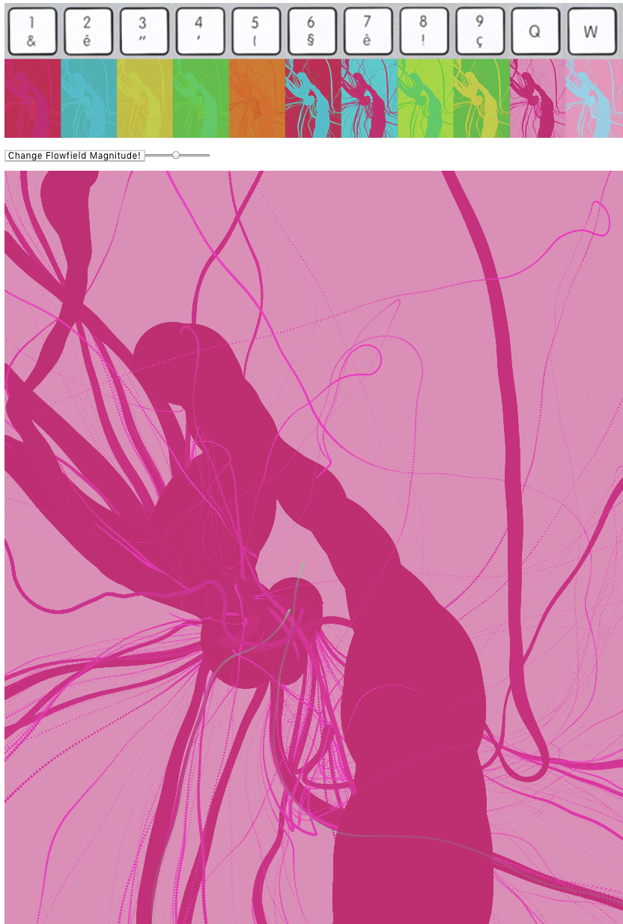
8. Added magnitude slider, colour combinations and keypressed functionality

Slide 10


